Slide 1

Department of Electronics and Communication Engineering
Smart Road Safety: An AI-Powered Approach for Real-Time Accident Risk Prediction
Name of the Guide
Mrs. G. Durga Bhavani
Students Name and Roll Numbers
1. K.Risheeka - 218T1A0475
2. K.Yaswanth - 218T1A0469
3. L.Bhavya - 218T1A0479
4. P Rambabu - 228T5A0422
.

Slide 2
Contents
Abstract
Introduction
Literature survey
Problem statement
Objective
Proposed technique
Results
Future scope
Conclusion
References

Slide 3
Abstract
Road accidents are a major global concern, causing significant loss of life and economic damage. This project, Road Safe, aims to develop a machine learning-based system that predicts and prevents road accidents by analyzing factors such as weather conditions, traffic density, driver behaviour, and historical accident data. By leveraging advanced machine learning models, the system provides real-time accident predictions and safety recommendations, thereby reducing risks and enhancing road safety.

Slide 4
Introduction
Road safety is a critical concern worldwide. With millions of accidents occurring annually, there is an urgent need for data-driven approaches to prevent accidents.
The integration of Artificial Intelligence (AI) and Machine Learning (ML) in road safety measures can significantly reduce accident rates by identifying high-risk areas, predicting accident probabilities, and alerting drivers in real time.
The advent of Deep Learning (DL) models such as Recurrent Neural Networks (RNN), Long Short-Term Memory (LSTM), Bidirectional LSTM (BI-LSTM), Simple Neural Networks (NN), and Gated Recurrent Units (GRU) has enabled the development of more sophisticated accident prediction systems.
This project aims to harness the power of ML and DL models to develop a robust accident prevention system that can accurately predict accident-prone areas and provide actionable insights for drivers and traffic authorities

Slide 5
Literature Survey
S.No | Title of the paper | Author’s name | Year of publication | observation
1 | Road Safe: A Machine Learning Based-Road Accident Prevention System | Caoxi Zhang, Anish Jindal | 2024 | The model learns the input from users and the road conditions along the suggested routes and gives predictions based on the data.
2 | Road Accident Severity Prediction using Ensemble Machine Learning | R. Nandal, M. Malik | 2023 | This project uses ensemble machine learning models like Random Forest and Extra Tree to predict road accident severity, achieving an accuracy of 81.06%
3 | Deep Learning for Road Accident Prediction | M. A. Khan, S. S. Rao | 2022 | This review paper discusses the application of deep learning techniques like CNNs and RNNs for road accident prediction, highlighting their potential for improving accuracy
4 | Road Accident Prediction using Machine Learning Approaches | S. S. Rao, K. S. Rao | 2020 | This project uses machine learning algorithms like decision trees and random forests to predict road accidents, achieving an accuracy of 85%

Slide 6
Problem statement
Road accidents are a major cause of fatalities worldwide, leading to loss of life and property.
Human errors, poor road conditions, and environmental factors contribute to accidents.
There is a need for an intelligent system that can predict accident risks based on various parameters.
Real-time alert system for drivers and authorities to take preventive measures.
A machine learning-based system that utilizes a Bi-LSTM deep learning model for risk assessment.

Slide 7
Objective
The primary objective of this project is to develop a Machine Learning-Based Road Accident Prevention System that leverages Deep Learning models for accurate accident prediction and prevention. The key objectives of the system include:
To develop a machine learning model that predicts road accidents: Implementing Deep Learning models such as RNN, LSTM, BI-LSTM, Simple NN, and GRU to analyze accident patterns and predict high-risk zones.
To analyze accident trends based on environmental and traffic data: Collecting and processing data from multiple sources, including real-time traffic feeds, weather conditions, road infrastructure, and historical accident reports.
To provide recommendations for preventing potential accidents: Utilizing predictive insights to offer real-time suggestions such as speed adjustments, alternate routes, and hazard alerts to drivers and traffic authorities.
To create a user-friendly system that provides real-time accident risk alerts: Designing an intuitive dashboard or mobile application that delivers real-time risk assessments and preventive recommendations to road users.

Slide 8
Proposed Technique
The system is designed to work solely on latitude and longitude inputs provided by users. Instead of collecting external data, it processes the provided coordinates to predict accident severity in real time. The methodology consists of the following steps:
Feature Engineering and Dimensionality Reduction:
Standard Scaler is used to normalize the data for better model efficiency.
Principal Component Analysis (PCA) is applied to reduce dimensionality while retaining essential features, improving model performance.
Handling Class Imbalance:
Synthetic Minority Over-sampling Technique (SMOTE) is employed to balance accident severity classes, ensuring the model is not biased toward common accident categories.
Data Splitting and Preparation:
Data is divided into training and testing sets with a 80-20 split, ensuring a balanced dataset for evaluation.
The dataset is reshaped to be compatible.

Slide 9
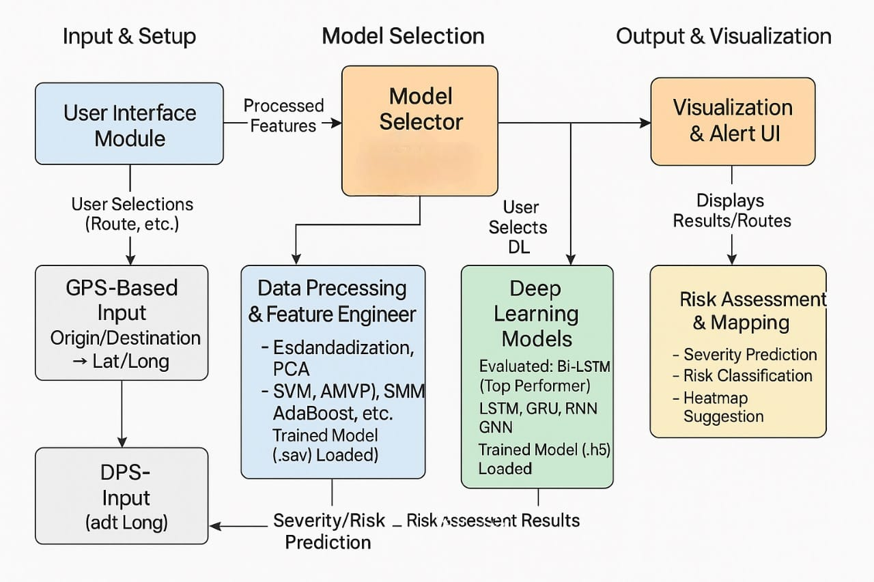
Block Diagram

Slide 10
Block Diagram Explanation
Input & Setup Layer
🔹 User Interface Module
This is the entry point of the system. It is a web or mobile-based application where users input details like their source and destination locations. This module collects user selections and initiates the risk assessment process.
🔹 GPS-Based Input
The inputted locations are processed using GPS-based services to convert them into latitude and longitude coordinates. These geographical coordinates are crucial for mapping and spatial analysis.
🔹 DPS Input (Data Point Storage / Historical GPS Input)
This optional block may refer to additional or historical GPS inputs (e.g., traffic patterns, past accident locations) which can be combined with user input for a more robust prediction.
2. Model Selection & Prediction Core
🔹 Data Processing & Feature Engineering
Once the location data is available, it is passed into this module for cleaning and transformation:
Standardization: Ensures all data values are on the same scale.
PCA (Principal Component Analysis): Reduces dimensionality for better computational performance.
SMOTE: Balances classes to handle skewed accident vs. non-accident data.

Slide 11
SVM, AMVP, AdaBoost, etc.: ML algorithms used here. This module loads pre-trained ML models stored in .sav format to generate predictions.
🔹 Model Selector
This intelligent module allows for dynamic selection between ML and DL models. The selection can be manual (user-defined) or automatic (based on performance or conditions). It acts as a bridge between feature engineering and the prediction stage.
3. Output & Visualization Layer
🔹 Risk Assessment & Mapping
This module analyzes the predictions from the selected model to determine:
Severity Level: Indicates how serious the accident risk is (e.g., Low, Medium, High, Critical)
Risk Classification: Categorizes the input data based on predefined risk levels
Heatmap Generation: Visualizes high-risk areas along the route using color gradients This step turns numerical predictions into actionable insights.
🔹 Visualization & Alert UI
The final output is shown to the user through an interactive interface that includes:
Route Map Display: With risk zones highlighted
Real-Time Alerts: Informing users of accident-prone zones ahead
Alternative Safer Routes: Suggested automatically for high-risk paths

Slide 12
Graphs
.
The results from multiple deep learning models, including Bi-LSTM (25 and 50 epochs), GNN, RNN, and LSTM, were analyzed to determine the most effective model for accident severity prediction. The key performance metrics used for evaluation include accuracy, precision, recall, and F1-score.
Model Performance Comparison (F1-score)
Metric | Bi-LSTM(50 epochs) | Bi-LSTM(25 epochs) | GNN | RNN | LSTM | Simple NN
Class 1 | 0.9850 | 0.9758 | 0.9678 | 0.8134 | 0.9746 | 0.8275
Class 2 | 0.8435 | 0.7455 | 0.6519 | 0.4744 | 0.6646 | 0.4846
Class 3 | 0.8505 | 0.6829 | 0.6192 | 0.5497 | 0.6780 | 0.5635
Macro Avg | 0.8499 | 0.8014 | 0.746 | 0.6125 | 0.7724 | 0.6381
Weighted Avg | 0.8502 | 0.8018 | 0.7466 | 0.6125 | 0.7726 | 0.6381
Accuracy | 0.8518 | 0.8054 | 0.7496 | 0.6177 | 0.7744 | 0.6381

Slide 13
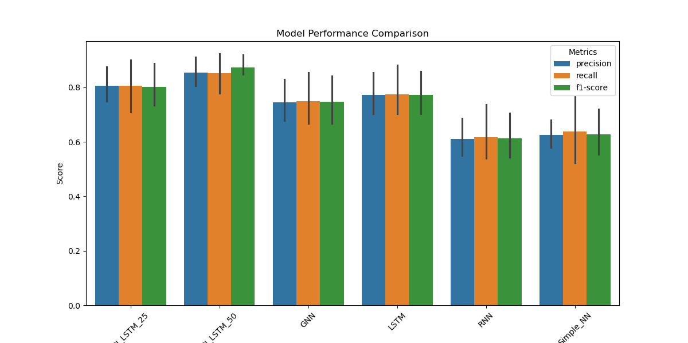
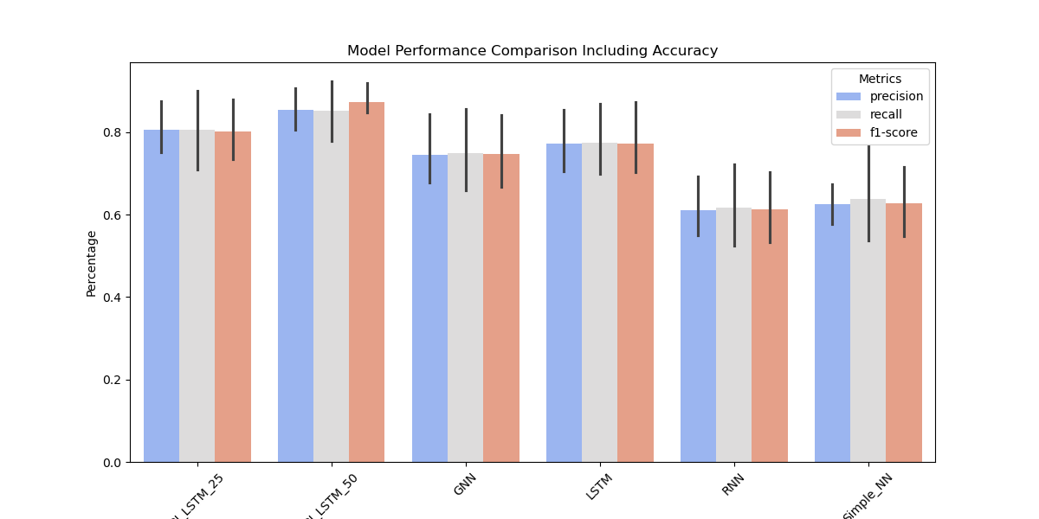
Model Performance Comparison – A bar chart comparing precision, recall, and F1-score for all models.

Slide 14
Machine Learning Model Performance Comparison
Similarly, various machine learning models were tested to compare their predictive capabilities. The ExtraTrees model achieved the highest accuracy and F1-score among all tested ML models, making it the most effective traditional machine learning approach.
Model | Class 1 (F1-score) | Class 2 (F1-score) | Class 3 (F1-score) | Accuracy | Macro Avg | Weighted Avg | Time (s)
AdaBoost | 0.7342 | 0.4216 | 0.7065 | 0.6208 | 0.6208 | 0.6208 | 51.054
Bagging | 0.9748 | 0.7775 | 0.8655 | 0.8726 | 0.8726 | 0.8726 | 424.94
EGAM | 0.9748 | 0.7775 | 0.8655 | 0.8726 | 0.8726 | 0.8726 | 424.94
ExtraTrees | 0.9878 | 0.8225 | 0.8484 | 0.8863 | 0.8863 | 0.8863 | 33.217
GradientBoosting | 0.7712 | 0.4431 | 0.8432 | 0.6858 | 0.6858 | 0.6858 | 347.323

Slide 15
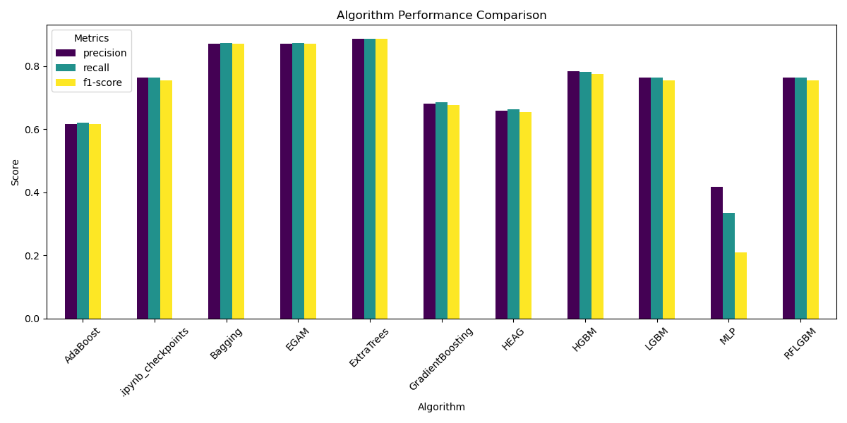
Best Performing Model Selection:
The Bi-LSTM model trained for 50 epochs achieved the highest accuracy of 85.18%, with a balanced precision (0.8539), recall (0.8512), and F1-score (0.8499). This model outperformed the 25-epoch Bi-LSTM, LSTM, and RNN models in overall accuracy and robustness in accident severity classification.Although the GNN model had a high recall (0.9921), its precision was significantly lower, indicating a tendency for false positives. Therefore, while it performed well in identifying severe accident cases, it lacked precision in accurately classifying all accident types.

Slide 16
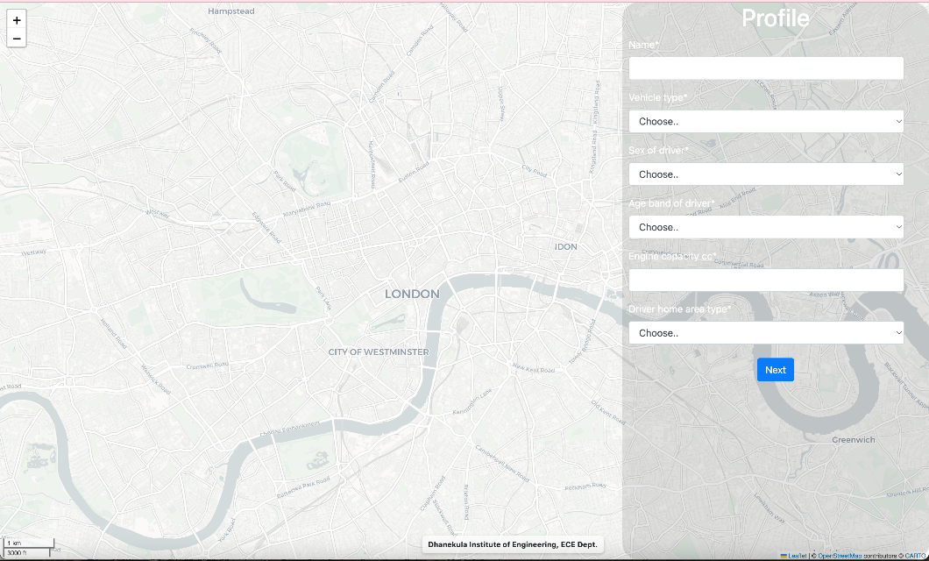
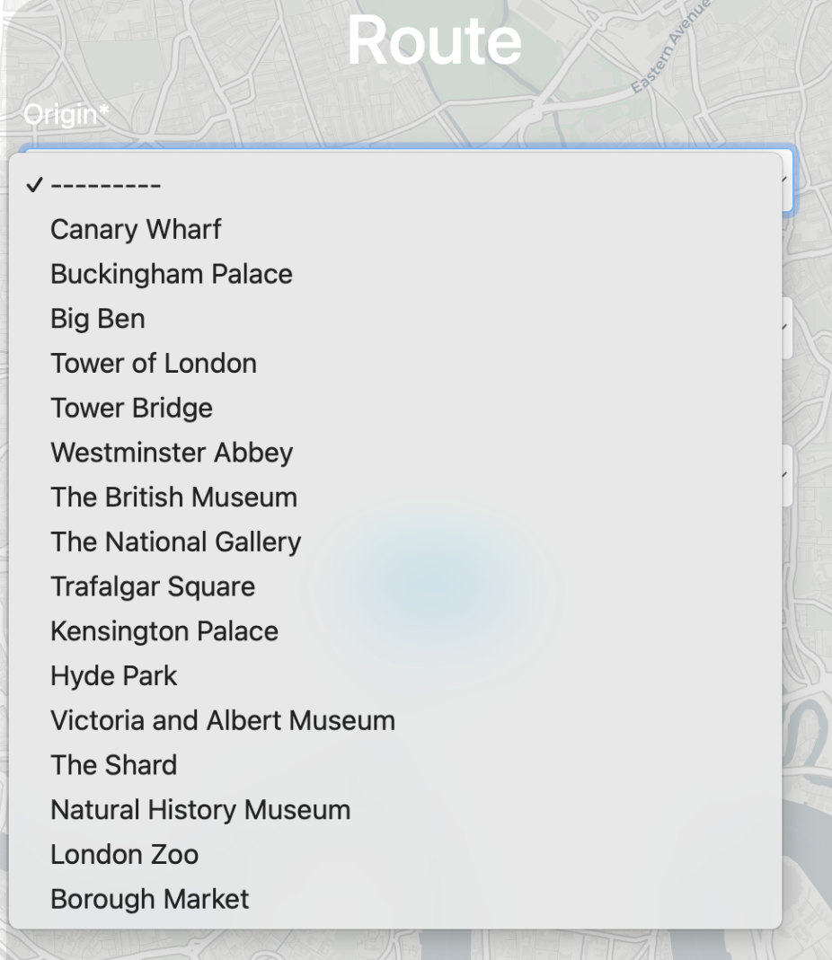
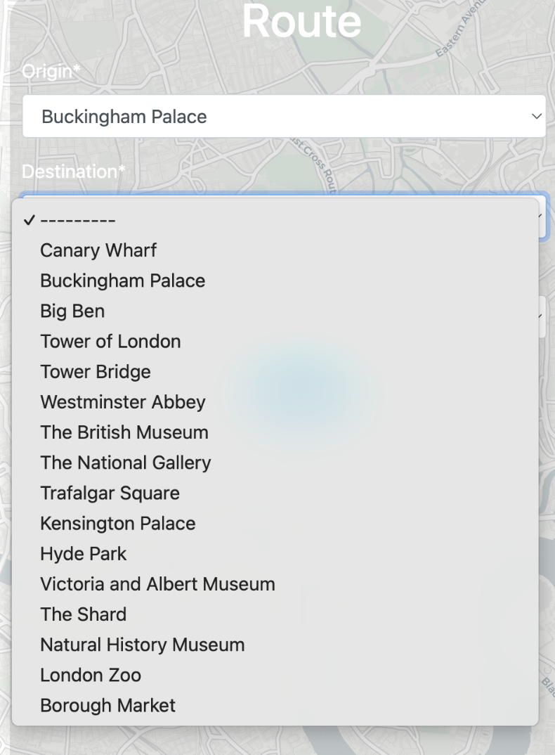
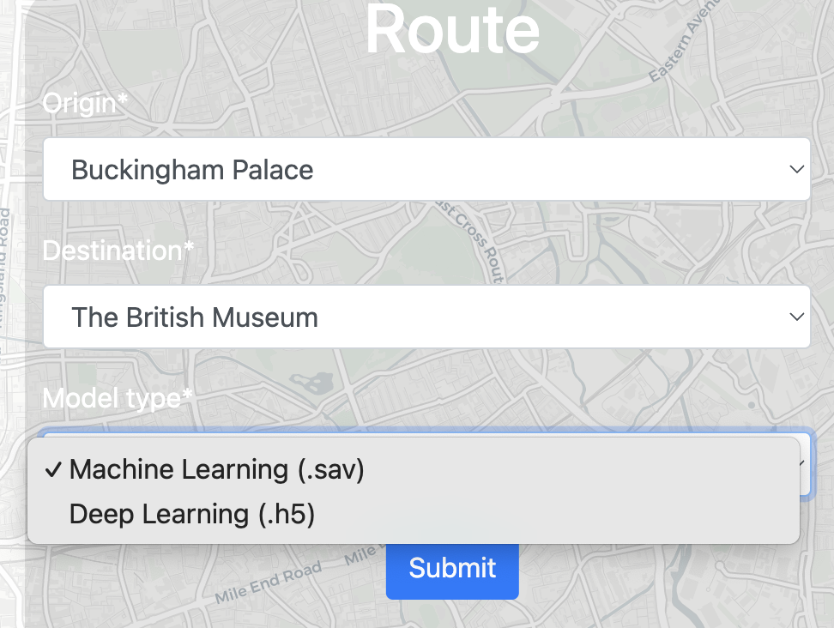
Results

Slide 17
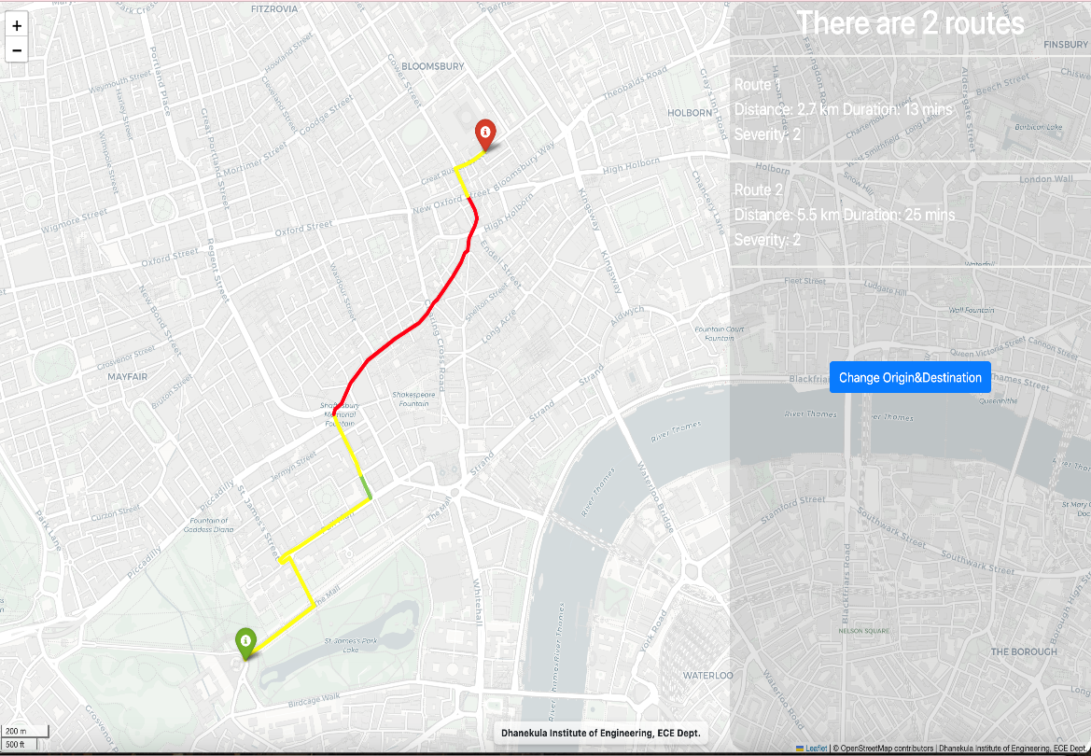
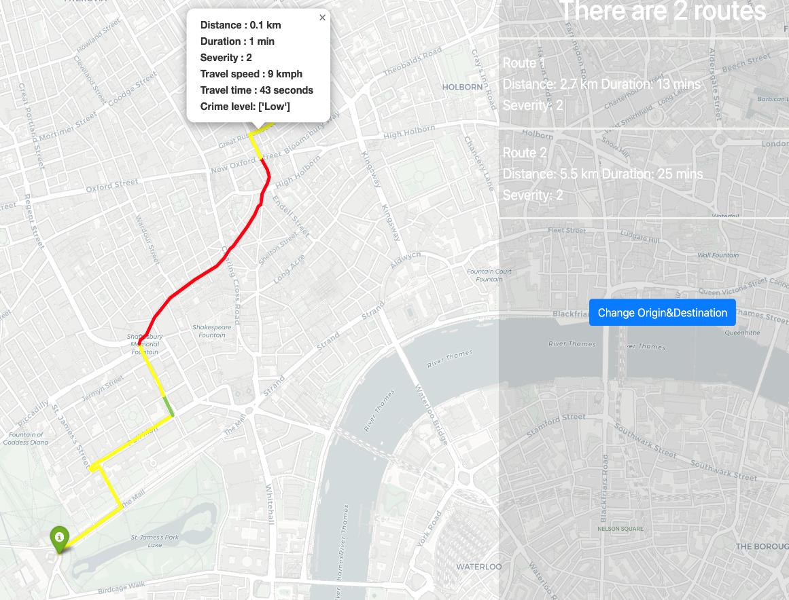
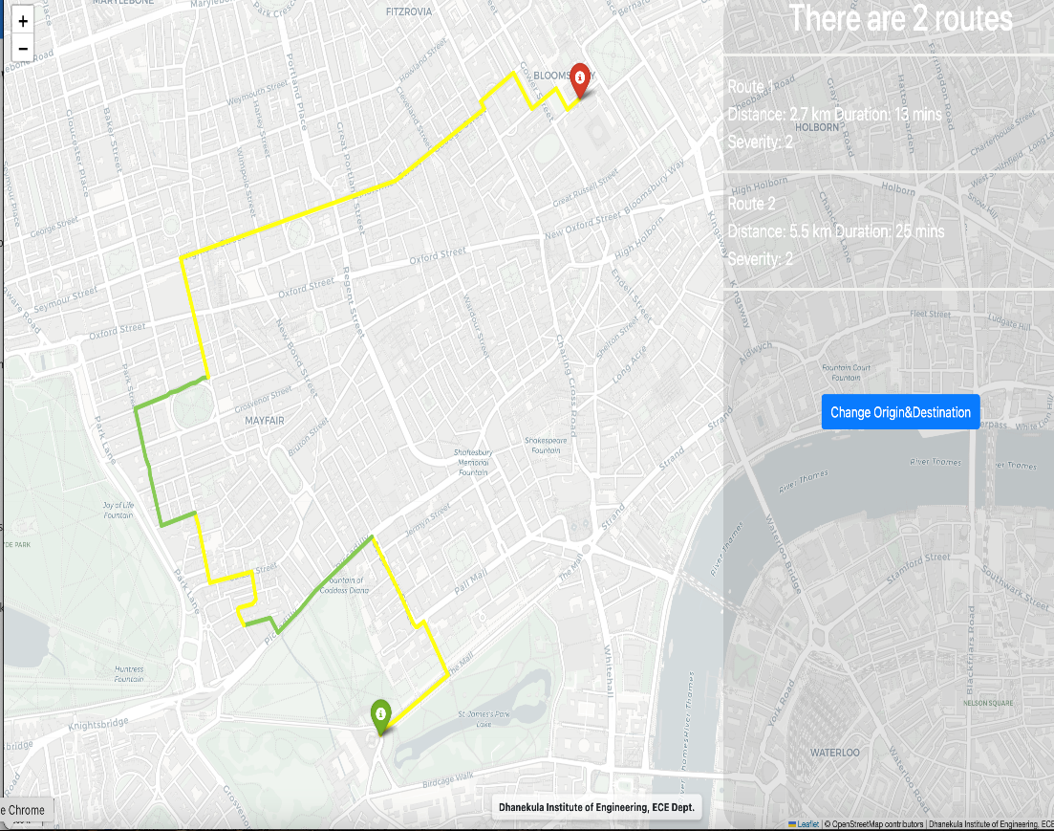

Slide 18
Future Scope
Expanding dataset coverage with real-time traffic and weather feeds.
Hyperparameter tuning for better model predictions.
Model training based on the number of features.
Enhancing deep learning models for better accuracy.
Deploying the system as a mobile application.
Integrating reinforcement learning for adaptive risk assessments.
Developing an alert system for emergency response teams.

Slide 19
Conclusion
Road Safe demonstrates the potential of machine learning in reducing road accidents by providing predictive insights. The ExtraTrees model outperformed other ML models in recall, accuracy, and computational efficiency, while the Bi-LSTM (50 epochs) model was the best-performing deep learning model. This system can be integrated into existing navigation and safety systems to enhance road safety globally. By utilizing ensemble models and real-time data integration, this system can help drivers make safer decisions and reduce accident risks on the road.

Slide 20
References
Swan, M, Sensor mania! the internet of things, wearable computing, objective metrics, and the quantified self 2.0, Journal of Sensor and Actuator networks, 1(3), pp. 217–253, 2012.
GOV.UK. (n.d.). Reported road casualties Great Britain, provisional results: 2022. [online] Available at: https://www.gov.uk/government/ statistics/reported-road-casualties-great-britain-provisional-results-2022/ reported-road-casualties-great- britain-provisional-results-:-2022#:∼: text=pre\%2Dpandemic\%20trends.- [Accessed 9 Aug. 2023].
GOV.UK. (n.d.). A valuation of road accidents and casualties in Great Britain: Methodology note [online]Available at https://assets.publishing.service.gov.uk/government/uploads/system/ uploads/attachment data/file/995110/rrcgb-valuation-methodology.pdf.- [Accessed 9 Aug. 2023].
Clarke, D.D., Ward, P., Bartle, C. and Truman, W., Killer crashes: Fatal road traffic accidents in the UK. Accident Analysis & Prevention, 42(2), pp.764–770, 2010.
Zantalis F, Koulouras G, Karabetsos S, Kandris D, A Review of Machine Learning and IoT in Smart Transportation, Future Internet, 11(4):94, 2019.

Slide 21
Thank You

